Slide 1
Notes:
Southern Africa is experiencing its worst drought in 100 years. Six countries have declared a state of emergency, and the UN has called for action to avoid a full-scale humanitarian disaster in the region.
Crops have failed, cattle are dying, and food is scarce and expensive. Extreme temperatures and a lack of rain means families in these countries have very little to get them through until the next harvest, which is expected to be very lean again this year.
The situation is desperate. Families have little to no food to put on the table and an estimated 21 million children are suffering from malnutrition.
Mary’s Meals is providing a lifeline to families in Malawi, Mozambique, Zambia and Zimbabwe – four of the worst-affected countries in the region – by serving nutritious meals to children in schools.
Our meals bring hope. They encourage children into the classroom and give them energy to learn. This means, even in this most difficult of times, these children can make the most of their education and help break the generational cycle of poverty.

Slide 2
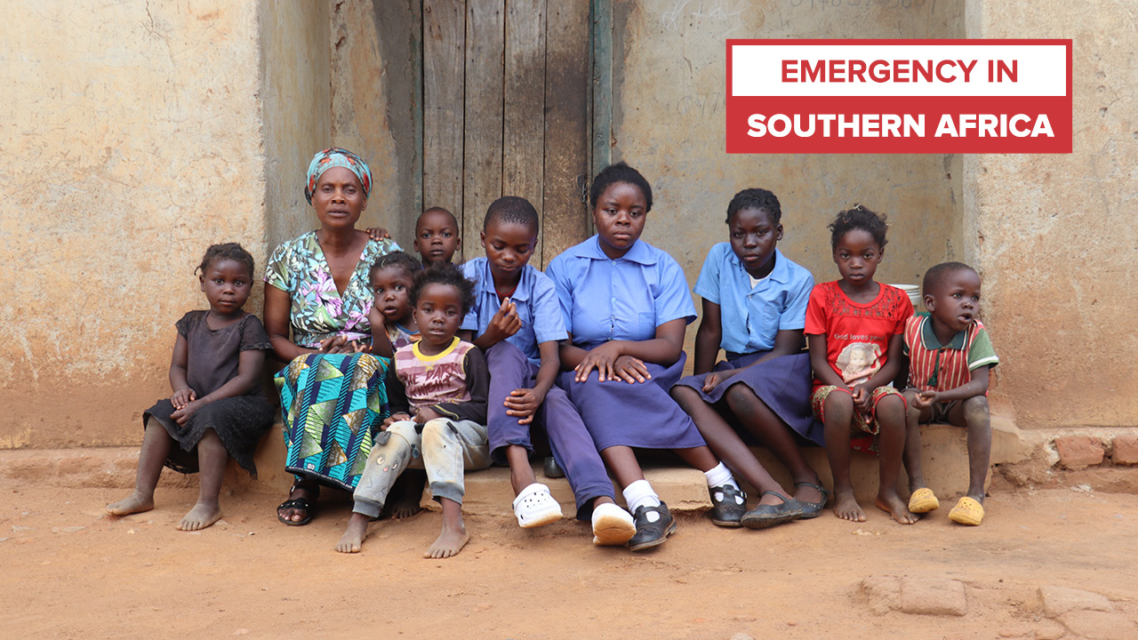
Notes:
Meet Euphrasia Banda, a grandmother from Zambia. She cares for her 10 grandchildren after the drought forced their parents to leave home to find work.
She says: “They couldn’t just stay home doing nothing. We have no income. This drought has pushed us to the edge of our lives.”
For the past two months, the family have had nothing to eat but unripe mangoes or maize bran gathered from the community mill.
Amid these struggles, Euphrasia finds hope in her 15-year-old grandson, Mangani. He eats Mary’s Meals every school day. He says: “We are happy because there is clean and nutritious food at school. It makes me energetic and focused.”
Euphrasia says: “I don’t know how to thank you, Mary’s Meals. The porridge you feed these children at school is a blessing to me. I don’t mind not eating anything. When my grandchildren have something to eat, my heart rests.”
Our school meals are vital relief to families like Euphrasia’s. The promise of Mary’s Meals means they know their children will eat at school and they can stretch the little food they have at home further.
We are currently reaching 1.5 million children in the region with our nutritious school meals. But there is more we can do. We need your help to bring more children back from the brink of desperation. With your support, we can reach many thousands more children waiting for our daily meals.
To donate to help families like Euphrasia’s or find out more about the emergency appeal, please visit www.marysmeals.org.uk/southern-Africa

Slide 3
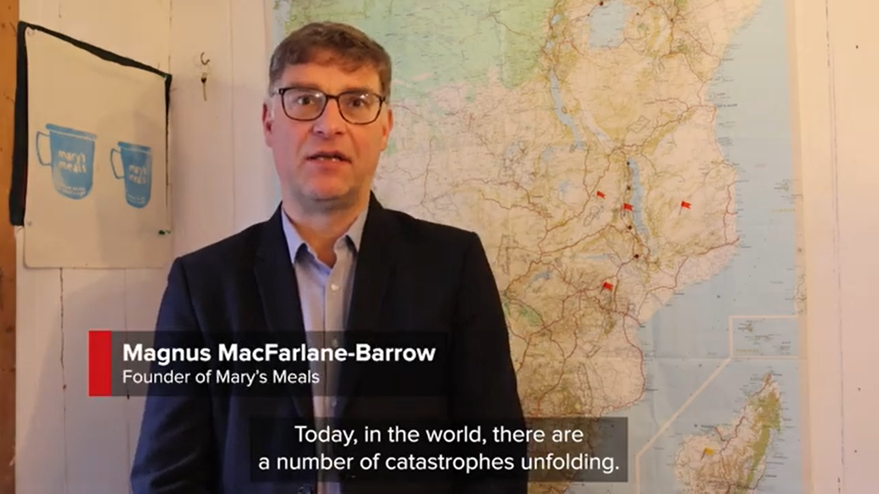
Notes:
Mary’s Meals Founder, Magnus MacFarlane-Barrow speaks about the current situation in Southern Africa.
Please click the slide to watch the video on Mary’s Meals YouTube channel or click the following link: https://youtu.be/IDgZinbfKJA

