Slide 1
Recruitment pack for:
Finance Officer (12 months maternity cover)
Mary’s Meals UK
January 2022

Slide 2
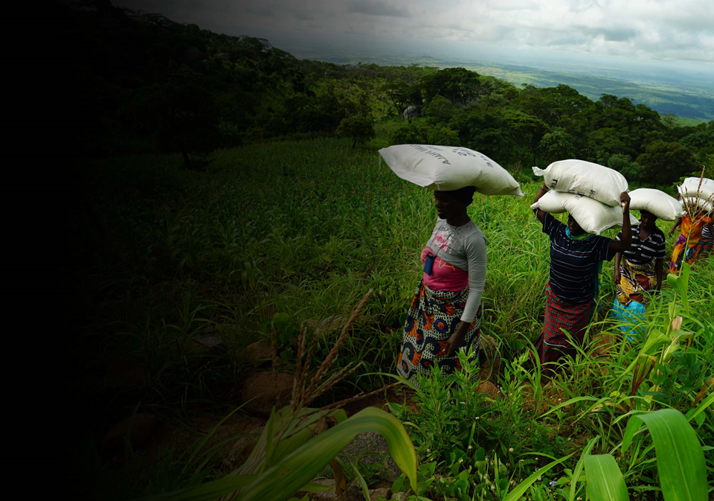
Recruitment pack contents
Welcome from our 3 Executive Director
Our vision, mission 5 and values
About the Mary’s Meals 7 movement
About Mary’s Meals UK 9
Role outline 11 and specification
Recruitment process 16 information
2

Slide 3
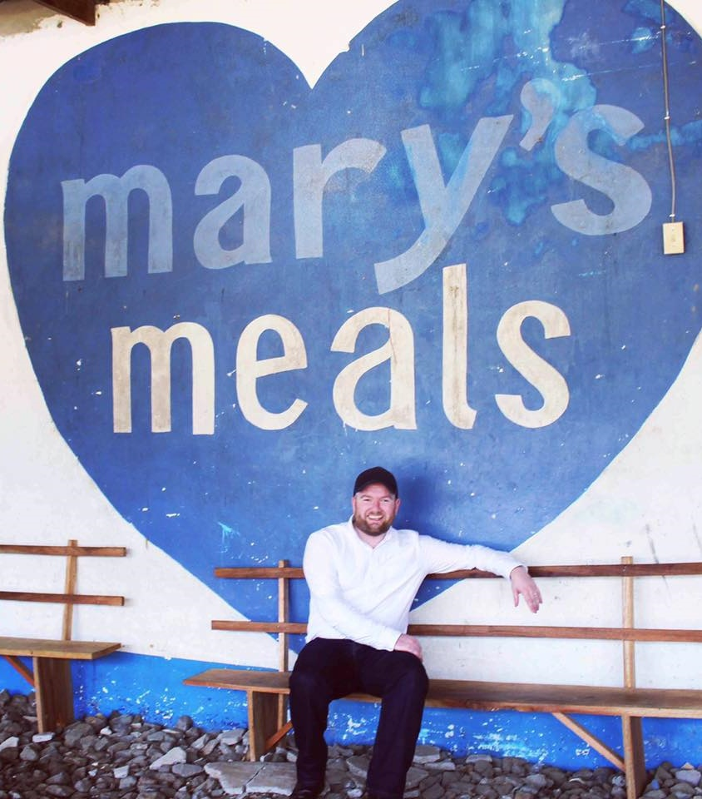
Welcome from our Executive Director
Thank you so much for your interest in joining the Mary’s Meals family. As you consider making an application for the role of Finance Officer with Mary’s Meals UK, I hope you find this pack helpful, encouraging, and exciting.
In joining Mary’s Meals UK, you would become part of a global movement of people who will simply not accept that any child should go hungry in this world of plenty. We are passionately driven by our simple belief that every child in the world deserves an education – and enough to eat.
From small beginnings feeding just 200 Malawian children in 2002, we are now reaching 2,058,099 children across 20 programme countries (including Malawi, Liberia, Zambia, Haiti, South Sudan, and Syria) with a nutritious daily meal in school.
This meal not only meets the immediate needs of the hungry child, but it attracts children to the classroom, where they can gain an all-important education. And we firmly believe that the children who are receiving Mary’s Meals today can grow up – better nourished and better educated – to become the men and women who will lift their communities out of poverty and end their reliance on aid.
3

Slide 4
Welcome from our Executive Director
None of this would be possible without the incredible generosity of our supporters all over the world, who give freely of their time, money, skills, and prayer. In Malawi alone, we have 80,000 volunteers who rise early each day to serve Mary’s Meals to children in their community.
And, across Mary’s Meals’ dozen or so ‘national affiliate’ countries, in which we raise awareness and funds for our work (including the UK, USA, Austria, Germany, Ireland, Croatia and Canada), thousands of people amaze and inspire us every day with their ‘little acts of love’, spreading the word about Mary’s Meals in their local communities and raising money to feed more children.
The UK, where we received the first-ever donations for our work, remains the country in which Mary’s Meals raises the majority of its funds. And Mary’s Meals UK, the organisation I am privileged to lead is responsible for continuing to tell our story across Scotland, England, Northern Ireland and Wales; engaging and inspiring more and more UK volunteers and donors; and driving forward the unrelenting growth of the Mary’s Meals movement on these shores.
We do this while working very closely and collaboratively with our colleagues at Mary’s Meals International, the organisation which co-ordinates the global movement and directly manages our school feeding programmes.
The Finance Officer plays an important role in the mission, supporting and assisting the Finance Manager in providing day to day financial and management accounting for the charity, ensuring accurate, timely and efficient delivery of the accounting services.
With more than 58 million children out of school around the world and a further 73 million attending school so hungry, they’re unable to concentrate and learn, our work is only just beginning. Will you play a crucial part in shaping the future of Mary’s Meals UK and, with it, the lives of so many people who both contribute to and benefit from this incredible work of love, joy, and hope?
I look forward to hearing your story.
Daniel Adams
Executive Director, Mary’s Meals UK
4

Slide 5
Our vision and mission
• Our vision is that every child receives one daily meal in their place of education and that all those who have more than they need, share with those who lack even the most basic things.
• Our mission is to enable people to offer their money, goods, skills, time, or prayer, and through this involvement, provide the most effective help to those suffering the effects of extreme poverty in the world’s poorest communities.
5

Slide 6
Our values
• We have confidence in the innate goodness of people.
• We respect the dignity of every human being and family life.
• We believe in good stewardship of the resources entrusted to us.
View Mary’s Meals’ full statement of values here: Statement of Values
6

Slide 7
About the Mary’s Meals movement
Mary’s Meals is a global movement that sets up school feeding projects in some of the world’s poorest communities, where poverty and hunger prevent children from gaining an education.
Our idea is a simple one that works. We provide one daily meal in a place of learning in order to attract chronically poor children into the classroom, where they receive an education that can, in the future, be their ladder out of poverty.
The Mary’s Meals campaign was born in 2002 when Magnus MacFarlane-Barrow, from Dalmally in Argyll, visited Malawi during a famine and met a mother dying from AIDS. When Magnus asked her eldest son Edward what his dreams were in life, he replied simply: “I want to have enough food to eat and to go to school one day.”
That moment was a key part of the inspiration which led to the founding of Mary’s Meals, which began by feeding just 200 children in Malawi in 2002. Today, 20 years later, we feed 2,058,099 hungry children every school day across four continents. The average worldwide cost for us to feed a child for a whole school year is just £15.90.
Where Mary’s Meals is provided, there is a rise in school enrolment, attainment and attendance. Wherever possible, Mary's Meals uses locally grown food to support the local economy and help smallholder farmers.
We work extremely hard to keep our running costs low and to ensure that at least 93% of donations goes directly on our charitable activities. This is only possible because most of our work is done by an army of dedicated volunteers all over the world, who carry out lots of little acts of love on behalf of Mary’s Meals.
Having been inspired, in part, by our founder’s Catholic faith, this work is named in honour of Mary, the mother of Jesus, who brought up her own child in poverty. We consist of, respect and reach out to people of all faiths and none.
Counting on support from around the globe, Mary’s Meals has registered national affiliate organisations, which raise awareness of our work, in more than 19 countries around the world. Funds raised by affiliates, including from Mary’s Meals UK, are passed to Mary’s Meals International, the organisation which co-ordinates our movement and directly manages the delivery of our school feeding programmes.
7

Slide 8
8

Slide 9
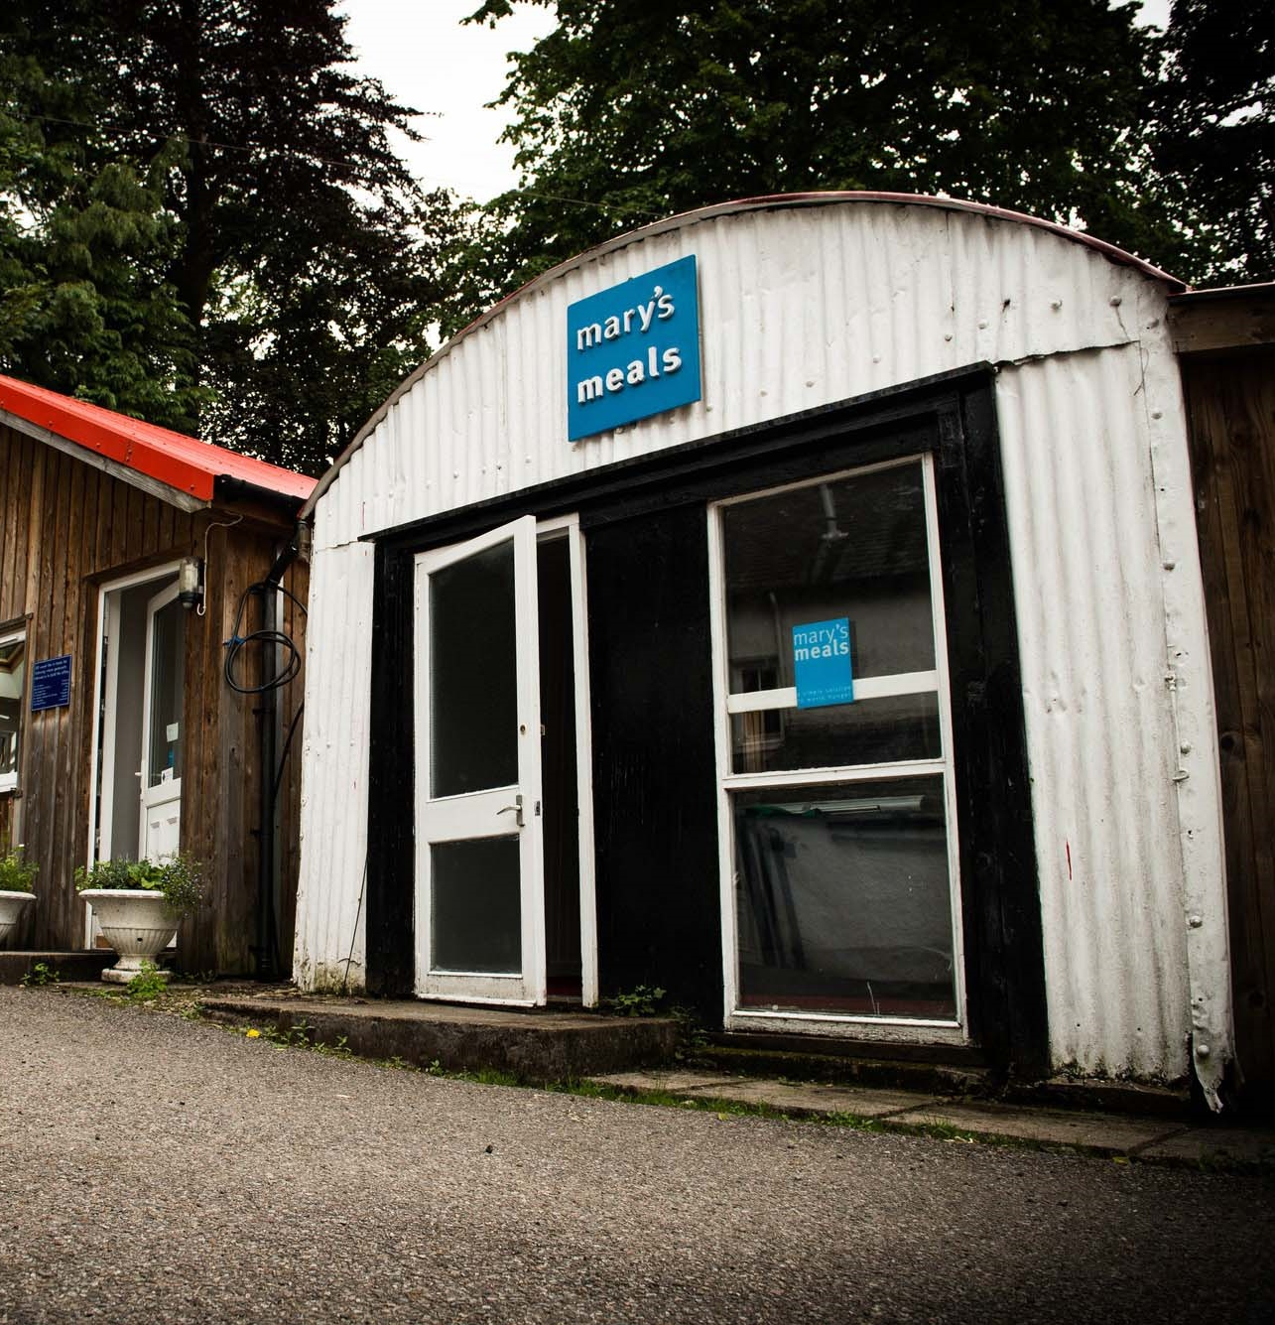
About Mary’s Meals UK
Mary’s Meals UK (or ‘MMUK’), a charity registered in Scotland, is the oldest entity in the Mary’s Meals family – the original organisation established as Scottish International Relief in the early 1990s, when our founder and global CEO, Magnus MacFarlane-Barrow, first became involved in international aid during the Bosnian Conflict.
Back then, Magnus was a simple salmon farmer who, along with his family, decided to do something to help those who were suffering because of the war.
They relied heavily on the generosity of local people in their village of Dalmally in Argyll, who relentlessly donated food, blankets and other items of aid, which were then stored in the family shed, before being driven out by Magnus to Bosnia-Herzegovina.
Though our largest office is now in Glasgow, that same shed – which continues to be filled, metaphorically at least, with the generosity of our supporters – still serves as the headquarters of Mary’s Meals UK to this day.
9

Slide 10
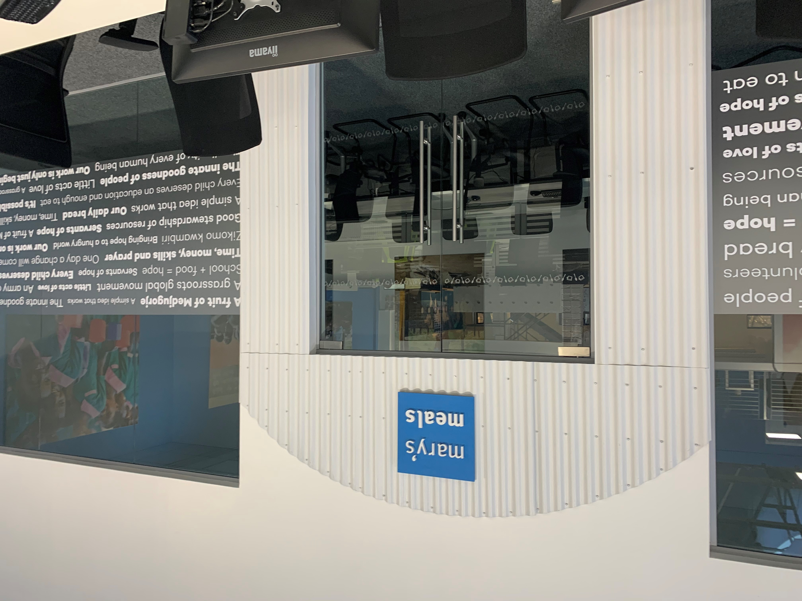
About Mary’s Meals UK
In January 2015, to recognise the incredible growth of the Mary’s Meals movement around the world and to facilitate future growth in new countries, another entity – Mary’s Meals International (or ‘MMI’) – was formed.
This new organisation assumed responsibility for directly delivering our programmes and for coordinating the growing number of Mary’s Meals organisations around the world, aimed at either awareness-raising or programme delivery.
This structural change saw Mary’s Meals UK become the global movement’s largest fundraising organisation and enabled it to focus even more passionately on its mission to tell our story across Scotland, England, Northern Ireland and Wales, and empower more people to help us reach the next hungry child by offering their money, goods, skills, time or prayer.
Today, Mary’s Meals UK raises awareness and funds under the direction of the Executive Director, and through the passion, commitment and dedication of our volunteers and staff, led by the Director of Communications, Director of Supporter Engagement and Income, and the Director of Finance and Operations. The organisation currently has offices in Glasgow, Dalmally and London and works to a hybrid working practice of 3 days at home, 2 days in office.
10

Slide 11
Role outline
Role title: Finance Officer
Location: Office based, Glasgow (3/2 model, working 3 days from home and 2 in our office) or home working from anywhere in the UK.
Contract: Full time, Fixed term (12 months Maternity cover)
Salary: c. £26,025 per annum
Benefits: Flexible working, 34 days’ annual leave
(including public holidays), and a
non-contributory pension with employer contributions of 8%. For more information on what we offer, please visit: http://bit.ly/2F9lVlQ
Reports to: Finance Manager
Key relationships:
Internal: Staff
Managers
External: Supporters
Donors
Mary’s Meals UK
Finance team structure
Director of Finance & Operations
Head of Finance
Finance Manager (Expenditure)
Senior Finance Manager
(Income)
1x Vacancy
1x Finance Officer
1x Finance Business Partner
1x Finance Officer
11

Slide 12
Duties and responsibilities
Role overview
The Finance Officer oversees the transactional work of the finance department, ensuring that income and expenditure are recorded in the accounting system in an accurate and timely manner, ensuring that expenditure is appropriately authorised, and that payments are accurately and efficiently processed.
Principal duties
To provide support and be the first point of contact to each of the Directorates in MMUK for all expenditure related matters. Establish regular communication with each of the Directorates to support existing business processes and provide guidance for any potential changes to business processes which have a financial impact. Communicate any relevant changes back to the wider finance team.
To administer and oversee the purchase ledger process, ensuring that documentation is correct and properly authorised, that coding is appropriate, and that payment is made in the most efficient and cost-effective manner
To ensure the correct coding and analysis is used for VAT on purchase invoices
To prepare quarterly VAT returns for submission to HMRC
Prepare the annual VAT partial exemption adjustment
To provide the cash balance information to the Finance Manager for the monthly funds transfer to MMI
Prepare the monthly prepayment and accrual journals
Prepare and record the monthly restricted reclass journal for the funds transferred to MMI. On a quarterly basis confirm the reconciliation of balances to MMI
Accurately record material aid transactions in liaison with the warehouse team
Maintain the charity’s fixed asset register, including preparing depreciation / addition / disposal journals. Support the Operations Directorate in the annual fixed asset verification
Prepare and review the monthly shop P&L
Analyse monthly expenditure against budget, investigating and documenting explanations for any significant variances
Assist the Finance Manager in the preparation of the expenditure elements of the monthly management information
12

Slide 13
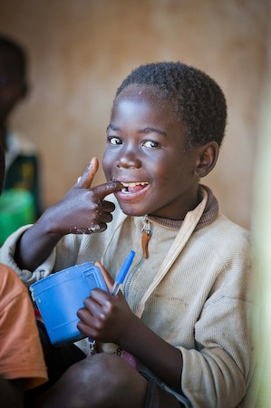
Duties and responsibilities
Support the wider finance team in any finance related matters
Assist the Finance Manager in preparation of the annual expenditure budget and audit requirements for the annual audit
Assist in the development, implementation and maintenance of appropriate financial policies and procedures
Deal with financial related queries, both internal and external as they arise
Contribute to team meetings and organisational priorities
Be proactive in keeping up to date with developments affecting the role, including any ad-hoc or ongoing training requirements, subject to the needs of the Charity
Abide by organisational policies and practices and the Charity’s values
13

Slide 14
Qualifications, experience and skills
Educated to HND level or equivalent professional experience
Numeracy skills and an ability to understand, analyse and manipulate complex information and data
Excellent communication skills and an ability to communicate financial information to non-finance colleagues, other partners and suppliers
Able to work independently and proactively, with the ability to consult wherever necessary
Excellent administrative and organisational skills
Able to use own initiative to identify improvements to systems and procedures within own level of authority
Experience of using and maintaining purchase ledger
Experience of using and maintaining databases
Experience and familiarity with Microsoft Word, Excel, Outlook and PowerPoint
Experience of a flexible approach to managing and prioritising a high workload and multiple tasks in a fast-paced environment with tight deadlines
Experience of organising and providing administrative assistance in an office environment
Experience of handling a wide range of enquiries and an excellent telephone manner
Knowledge of data protection act and responsibilities
Clear understanding of confidentiality with written and computerised materials and processes
Experience of working in a charity
Experience of using CRM databases
14

Slide 15
Mary’s Meals UK competencies
All Mary’s Meals UK employees approach their role in line with our 7S competency model:
1. Self
I build and demonstrate resilience
I lead by example
I’m authentic and true to Mary’s Meals values
I develop myself and set stretching goals
2. Service
I have a vocational attitude to my work
I inspire hope in others
I build belief that even difficult challenges can be solved
I am committed to serving and enabling all who want to be part of the global movement
I work to ensure our future will be even better than our past
3. Simplicity
I communicate effectively
I follow clear decision-making criteria
I create plans that are easy to follow and contribute to organisational goals
I embrace inclusivity and diversity
I focus on delivering results
4. Stewardship
I pay attention to the things that matter most; (a) our physical resources; (b) our people
I nurture, develop and respect our relationships with external stakeholders
I deliver on my promises
I am happy to be held accountable and to hold others to account
5. Strategy
I have a point of view about the future
I know our stakeholders and see our priorities clearly
I help others to work in ways that have the greatest impact
I develop strategy and translate it into action
6. Strengthen
I contribute to a positive work environment
I support those around me
7. Success
I maintain my technical competence
I contribute to the success of my team
I ensure accountability
I embrace change
15

Slide 16
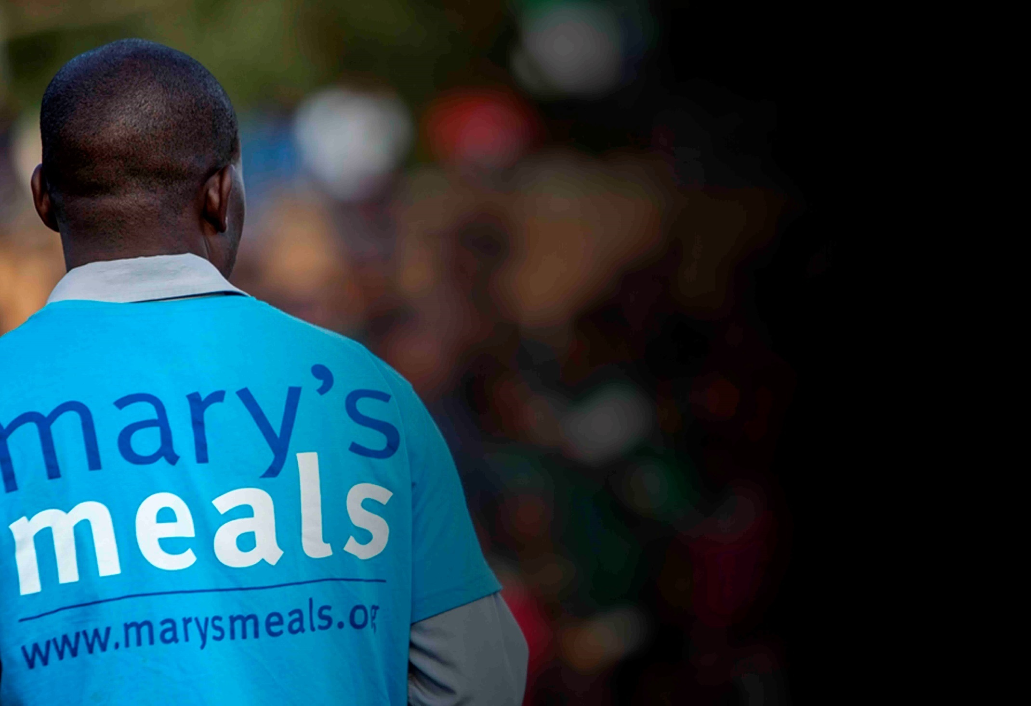
Recruitment process information
How to apply for this role
To apply for the role of Finance Officer based at Mary’s Meals UK, please send a tailored CV and covering letter to: Jobs@marysmeals.org
Your covering letter should make a compelling case for why you feel motivated to apply for this role within Mary’s Meals UK, as well as giving a concise overview of your most relevant skills and experience, and should fill no more than two pages of A4.
Please note: If you have any special requirements or adjustments before an interview, please let us know.
A second interview stage may be required.
16

Slide 17
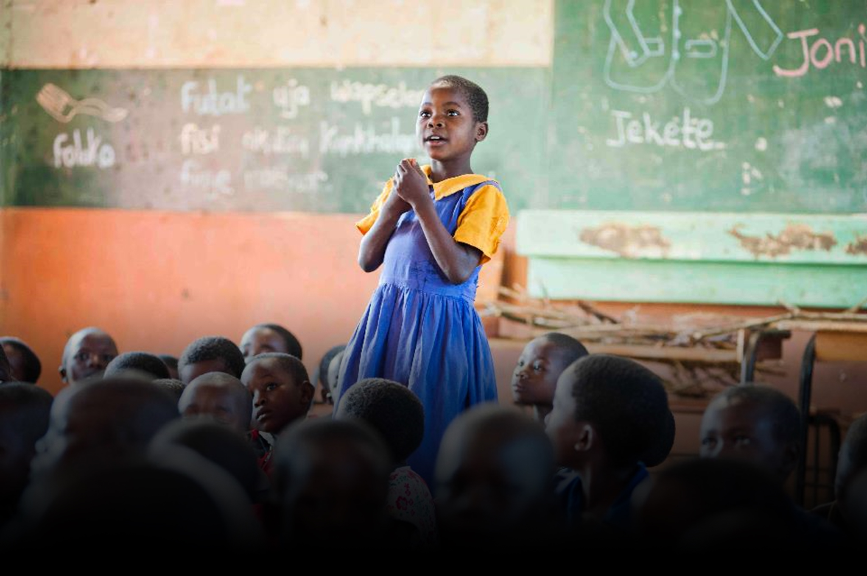
Mary’s Meals UK
Charity No. SC022140
Company No. SC265941
Tel: 0141 336 7094
Dalmally office
Craig Lodge
Dalmally, Argyll
PA33 1AR
Glasgow office
Unit 6 Claremont Centre
39 Durham Street, Glasgow
G41 1BS
London office
13 Hippodrome Place
Notting Hill, London
W11 4SF
“Together, let’s set out on this journey; one step at a time, one meal at a time, one child at a time.”
– Magnus MacFarlane-Barrow, Mary’s Meals founder

